Slide 1
Cognitively-Inspired Decision Intelligence for Manufacturing
Alessandro Oltramari¹ Siyu Wu^{1,2}
¹Bosch Center for Artificial Intelligence
Carnegie Bosch Institute
Pittsburgh, USA
²Penn State University
College of Information Science and Technology
State College, USA

Slide 2
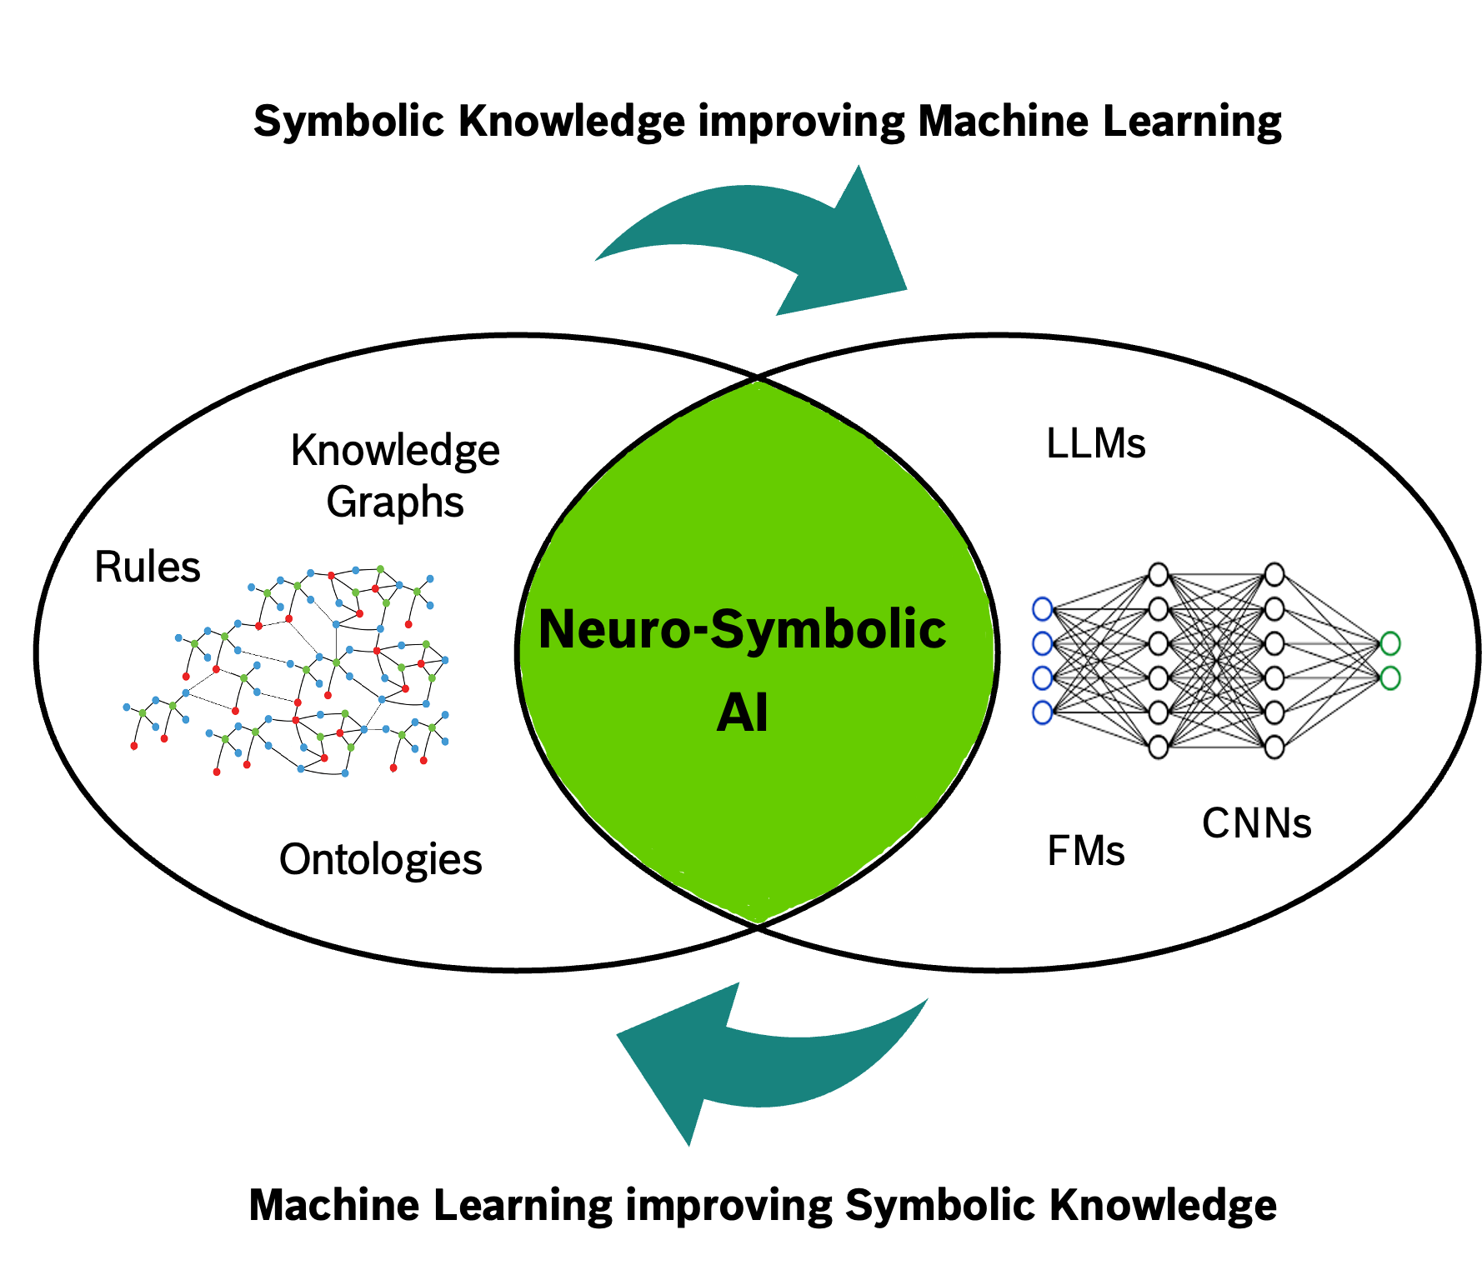
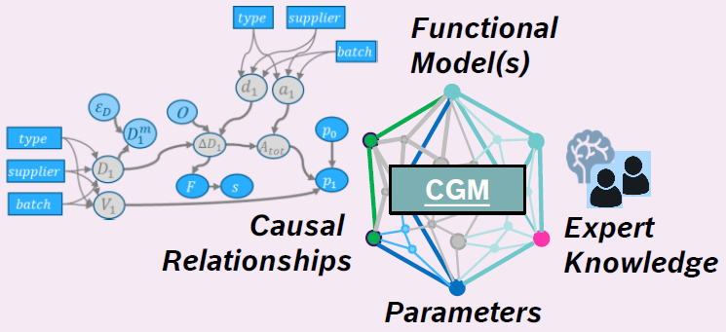
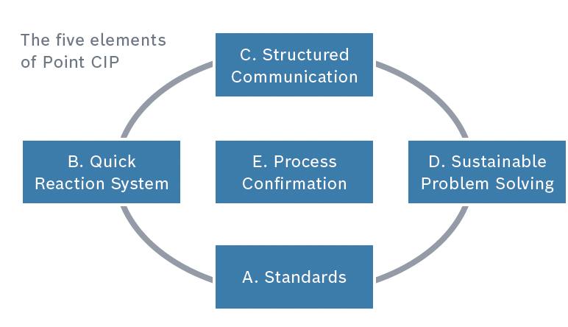
The Causal Analysis and Decision Intelligence Group (CADI)
Cognitively-Inspired Decision Intelligence for Manufacturing
neuro-symbolic ai
causal analysis
decision intelligence
Bosch has vast amounts of highly valuable data and rich domain expert knowledge
Neuro-Symbolic AI enables automatic distillation of insights from data and exploitation of expert knowledge for causal analysis and decision intelligence
Current focus on cost savings and process optimization in manufacturing
Causal AI is a set of techniques for discovering causal relations and making inferences beyond mere correlation
Causal Neuro-Symbolic AI is the integration of Causal AI with knowledge graphs and machine learning
Applications in manufacturing
Finding root causes for anomalies
Predicting the quality of products
Optimizing process chains
Decision intelligence (DI) aims to support, augment and automate human decisions by linking data with outcomes
Contemporary DI is genuinely neuro-symbolic as it combines machine learning algorithms with knowledge graphs and rule-based systems
Applications in manufacturing: Continuous Improvement Process (CIP)
Guide interventions during ramp-up phase of production line reconfiguration
Optimization of flexible manufacturing
*CGM: Causal Graph Model

Slide 3
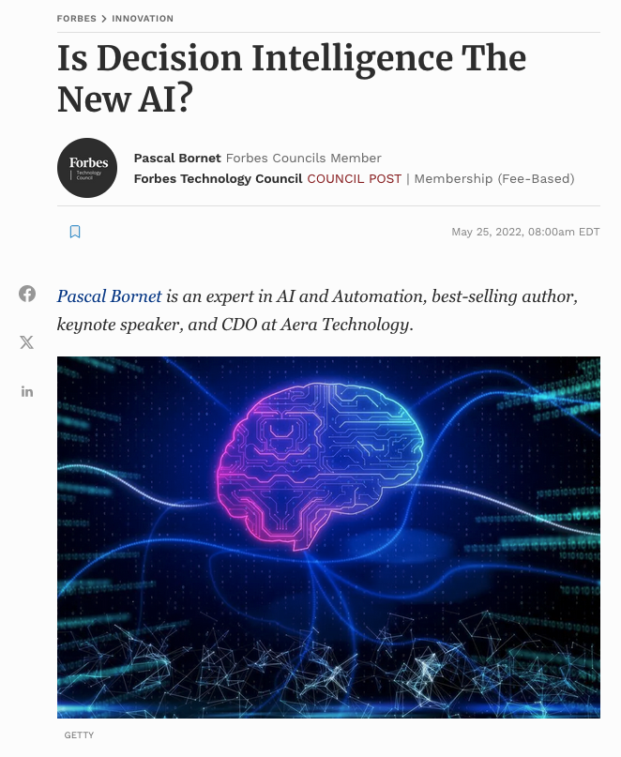
The Three Levels of Decision Intelligence
Cognitively-Inspired Decision Intelligence for Manufacturing
Decision Support
machines provide some basic tools to support human decision making, such as alerts, analytics and data exploration. The decisions themselves are made entirely by humans
Decision Augmentation
Decision Automation
machines perform both the decision step and the execution step autonomously. Humans have a high-level overview, monitoring the risks and any unusual activity and regularly reviewing outcomes to improve the system.
machines play a larger and more proactive role in the decision process. They analyze the data and generate recommendations and predictions for decision-makers to review and validate. Humans can make decisions based on the machine’s suggestions, or they can work cooperatively with the machine to amend the recommendation.
ACS 2024, | Alessandro Oltramari- 06.19.2024

Slide 4
Our R&D Approach
Cognitively-Inspired Decision Intelligence for Manufacturing
Realistic Scenarios
(Requirements + Ground Truth)
Simulation Framework
CADI projects adopt a unified methodological framework to tackle complex problems
Simulation data is often necessary within the manufacturing domain due to a lack of ground truth for learning; e.g. related to causal relations and decision processes
Neuro-symbolic methods are used to integrate prior domain knowledge with machine learning
We use realistic scenarios to elicit requirements for generating synthetic data and evaluate neuro-symbolic models
Our approach is iterative: after each evaluation stage we can refine the model and improve performance according to metrics of interest
We use cognitive architectures to model decisions
Synthetic data generation
Construction of
Neuro-Symbolic Model
Evaluation
Refinement

Slide 5




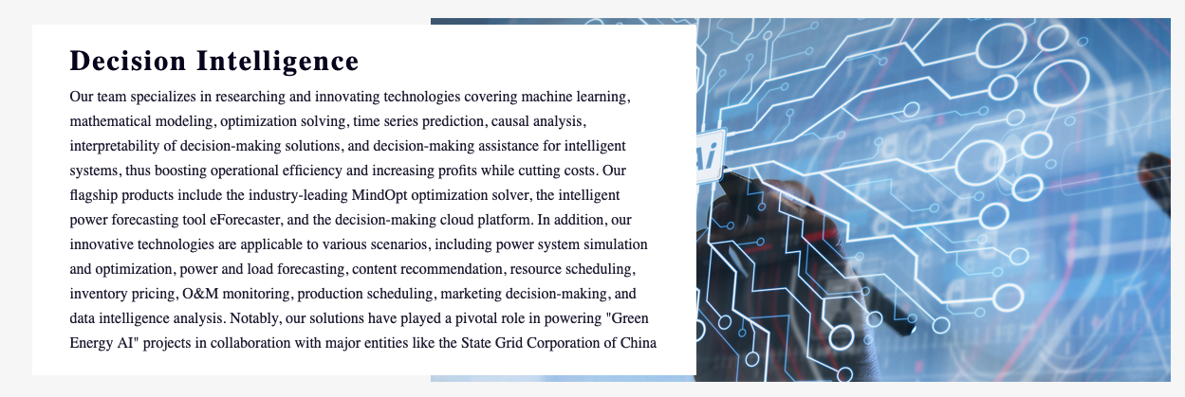

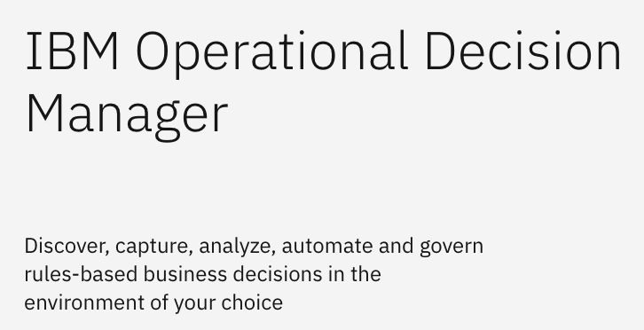


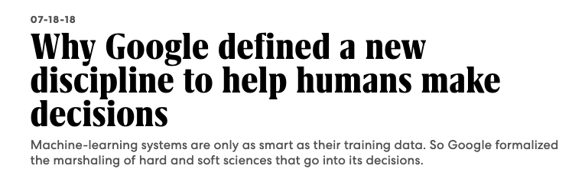
Landscape
Cognitively-Inspired Decision Intelligence for Manufacturing
Logistic Optimization
Demand Forecasting
Supply Chain Decisions
Causal Analysis
Power System Simulation and Optimization
Power and load forecasting
Resource Scheduling
O&M monitoring
Production Scheduling
Market Decision-Making
Content Recommendation
Inventory Pricing
Sustainability
Cybersecurity
Lab
ACS 2024, | Alessandro Oltramari- 06.19.2024
Notes:
DI is being adopted by the largest companies in the world. Google has created a department-bridging team of 17,000 employees to work in DI. Alibaba recently founded its own Decision Intelligence Lab to improve efficiency and reduce costs in areas such as content recommendation, inventory pricing, data analytics, asset allocation and capital arrangement.
Our clients Unilever and Reckitt Benckiser (RB) have both used DI technology to improve their supply chain. RB began using DI (also called “cognitive automation”) in its operations in 2018. Their aim was to make more data-driven decisions, notably using forecasting for their supply chain. Unilever’s approach was to ease employees’ workflows while promoting innovative new careers instead of simple data-entry-like tasks. Both companies also used the technology to make fast and responsive supply-chain decisions. This was strategically important in response to the sudden shifts in demand during the early months of the Covid-19 pandemic. To meet this shifting demand, the companies became more agile, optimizing their S&OP cycle from weeks to days or even hours.
Today, while most companies have tried to transform with AI, they all face the same issues: difficulties in scaling their transformations and generating the expected business impact. Decision intelligence helps provide this capacity. Have you already started your decision transformation?

Slide 6
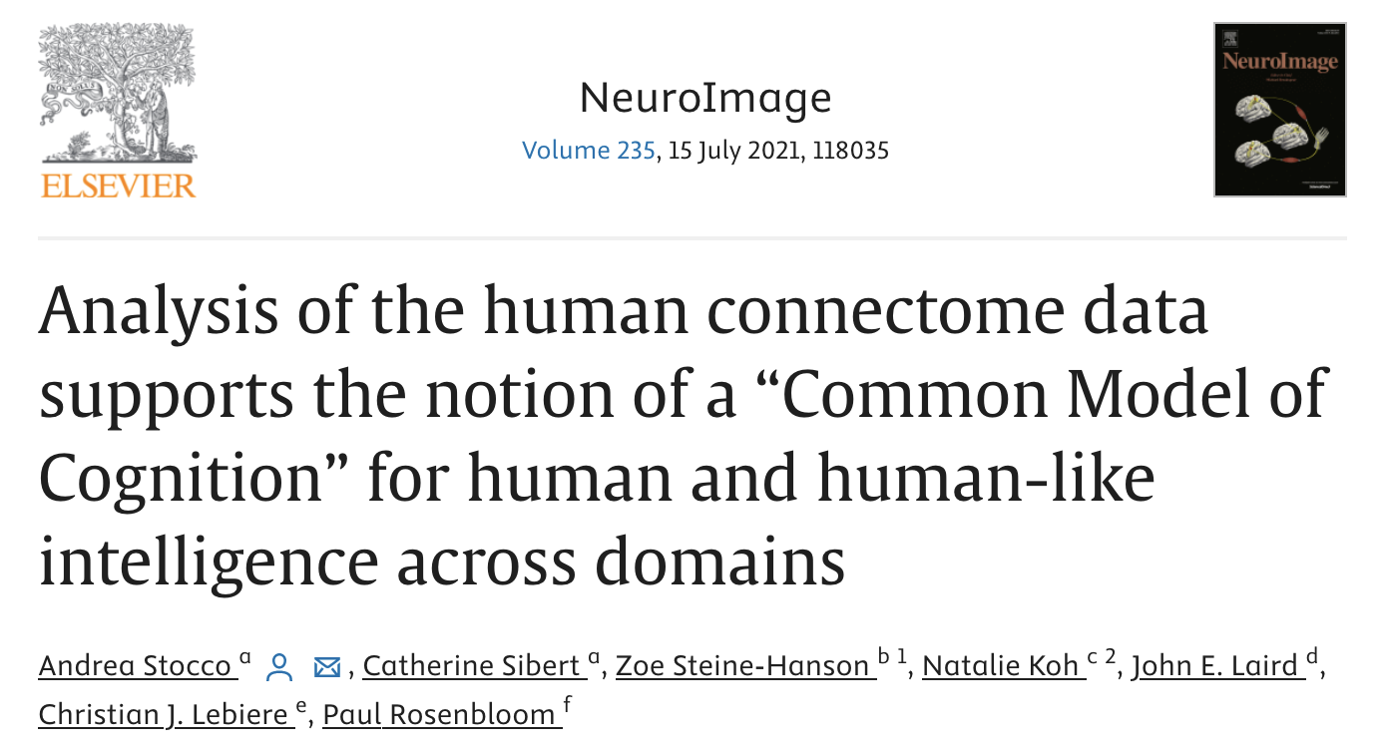
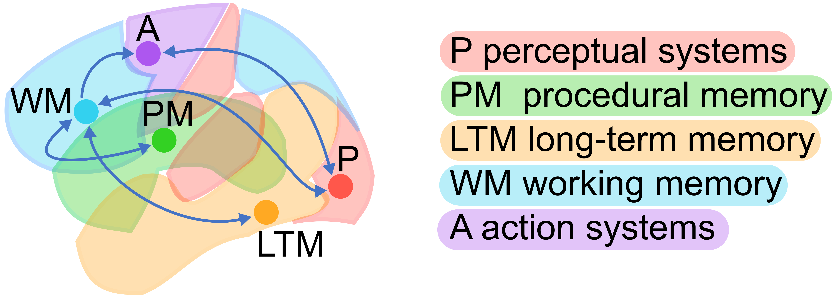

A Common Model of Cognition
Cognitively-Inspired Decision Intelligence for Manufacturing
Cognitive Architectures are computational frameworks that capture the invariant mechanisms of human cognition, including those underlying the functions of attention, control, learning, memory, adaptivity, perception and action
A Cognitive Model is the software artifact resulting from using a Cognitive Architecture to model a human task
The “Common Model of Cognition” is a recent development to consolidate four decades of research
Stocco, Andrea, et al. "Analysis of the human connectome data supports the notion of a “Common Model of Cognition” for human and human-like intelligence across domains." NeuroImage 235 (2021).
Sibert, Catherine, Holly Sue Hake, and Andrea Stocco. "The structured mind at rest: low-frequency oscillations reflect interactive dynamics between spontaneous brain activity and a common architecture for task control." Frontiers in Neuroscience 16 (2022)
Kotseruba, Iuliia, and John K. Tsotsos. "40 years of cognitive architectures: core cognitive abilities and practical applications." Artificial Intelligence Review (2018): 1-78.
CR/RSI1-NA|Alessandro Oltramari- 01.31.2024

Slide 7
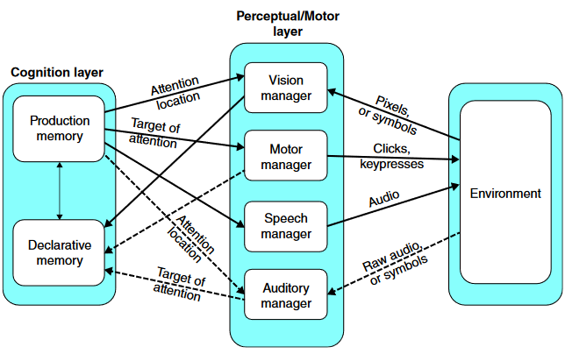
ACT-R: the Cognitive Architecture
Cognitively-Inspired Decision Intelligence for Manufacturing
“Architecture” refers to the fundamental organizational principle of a complex cognition system.
Modules are the sub-systems that t implement the cognitive mechanisms of cognition (e.g. retrieval from memory)
Productions: if-then rules, actionable memory
Core
Chunks:
factual memory, slot-value pairs
Image adapted from: Ritter, F. E., Tehranchi, F., & Oury, J. D. (2019). ACT-R: A cognitive architecture for modeling cognition.
Wiley Interdisciplinary Reviews: Cognitive Science, 10(3), Paper e1488. http://acs.ist.psu.edu/papers/ritterTOip.pdf
7

Slide 8
Approach and Goals
Cognitively-Inspired Decision Intelligence for Manufacturing
Integrating neural and symbolic levels within a genuinely-cognitive system framework can foster high-level reasoning typically required in complex decision scenarios
Looking back at decades of work in AI, our working hypothesis is that the modes of neuro-symbolic integration are methodologically variegate and task-dependent
Our current effort revolves around a question in line with most recent literature in neuro-symbolic AI: can we improve a large model by infusing contextual knowledge at scale? In particular, we are interested in infusing knowledge of the internal cognitive mechanisms underlying human decisions
We aim to answer to this question by empirically exploring various approaches
Fine-tuning LLAMA with cognitive model’s behavior (predictions) and internal state outputs (also called “trace”), and evaluating performance against relevant baselines (e.g., off-the-shelf pretrained models, human ground truth) is the goal for the summer
Novel contributions: elicit relevant semantic features of decision steps extracted from computational cognitive model’s behavior and replicate them into large models
ACS 2024, | Alessandro Oltramari- 06.19.2024

Slide 9
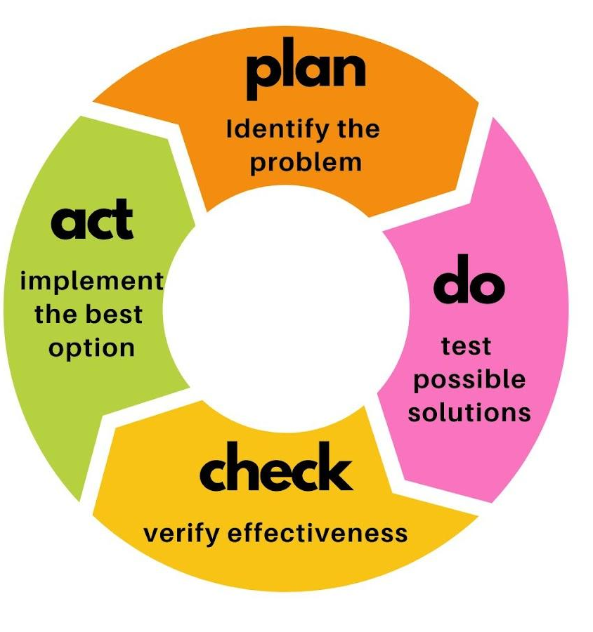
Use Case: Continuous Improvement Process (CIP)
Cognitively-Inspired Decision Intelligence for Manufacturing
Context: Flexible manufacturing for optimizing production lines and layouts
Dimensions: quantity, quality, time, cost
Problem: how to optimize operations depends on temporal scales: morning round (every day) or workshop (every quarter)
Morning rounds are time-consuming
Workshops are affected by redundancy and scale in the volume of information, and absence thereof
Approach: Neuro-Symbolic Cognitive Architecture
A solution that can support decision makers, especially at the macro-scale, improving their “situational awareness”
Cognitive models can replicate human decisions at different levels of expertise, and integrate learning algorithms with available knowledge
Integrated LLM
can be finetuned with synthetic data generated by cognitive model (scalability)
can bootstrap domain transfer of cognitive model (generalizability)
can be inspected for elicitation of decision steps (explainability)
CIP
ACS 2024, | Alessandro Oltramari- 06.19.2024
Notes:
They are looking for stable processes: they have small fluctuations in the processes → no flexibility / no robustness (of a line).
E.g.: Cycle time needs to be cut.
Thomas:
You can help us to understand us what is the most possible solution to improve x
Feedback from many past projects : look for material and then you can improve in the high level (provide EXPERT knowledge without the experts)
International Production Networks: same products in different regions → needs to be standardized how the problems are addressed
Problem of fluctuations
KPI slides can be shared by Thomas
Data from which plants?
Is there a plant in NA that can help here?
Every plant that produces has a value stream (Charleston/Anderson) - Look at the BPS contact.
All PS projects in Charleston use MyMeasure (useful to look at the projects that exist)
Central part of BPS should be involved
SEND INVITE TO THOMAS AND JOHANNES

Slide 10
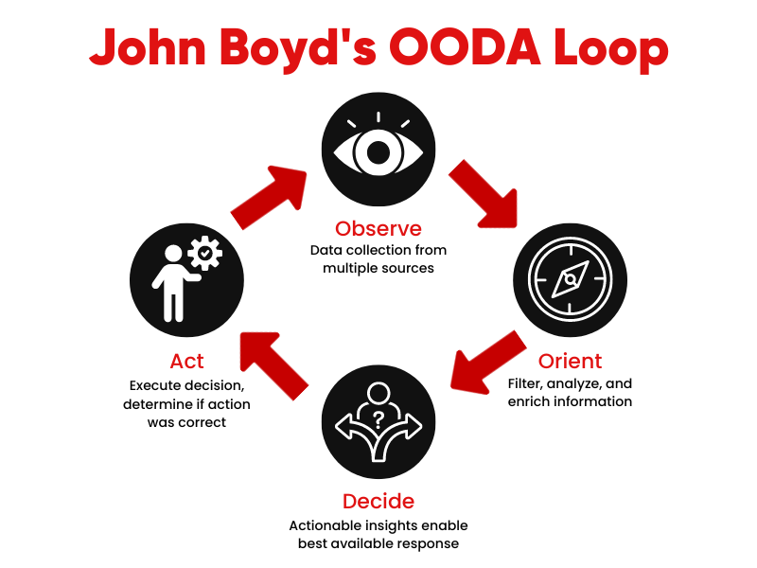
Use Case: Continuous Improvement Process (CIP)
Cognitively-Inspired Decision Intelligence for Manufacturing
Context: Flexible manufacturing for optimizing production lines and layouts
Dimensions: quantity, quality, time, cost
Problem: how to optimize operations depends on temporal scales: morning round (every day) or workshop (every quarter)
Morning rounds are time-consuming
Workshops are affected by redundancy and scale in the volume of information, and absence thereof
Approach: Neuro-Symbolic Cognitive Architecture
A solution that can support decision makers, especially at the macro-scale, improving their “situational awareness”
Cognitive models can replicate human decisions at different levels of expertise, and integrate learning algorithms with available knowledge
Integrated LLM
can be finetuned with synthetic data generated by cognitive model (scalability)
can bootstrap domain transfer of cognitive model (generalizability)
can be inspected for elicitation of decision steps (explainability)
ACS 2024, | Alessandro Oltramari- 06.19.2024
Notes:
Boyd, John R. "The essence of winning and losing." Unpublished lecture notes 12, no. 23 (1996): 123-125.

Slide 11
The Task
Cognitively-Inspired Decision Intelligence for Manufacturing
A production line consists of two sections with potential defect sources: pre-assembly and assembly
Pre-assembly takes 40 seconds with an Overall Equipment Effectiveness (OEE) rate of 88%
Assembly, on the other hand, takes 44 seconds but has a lower OEE rate of 80.1%
To achieve a total assembly time reduction of 4 seconds, we need to identify which section can be optimized with minimal impact on defect rates.
It's important to note that reducing cycle time will also lead to an increase in headcount costs
ACS 2024, | Alessandro Oltramari- 06.19.2024

Slide 12
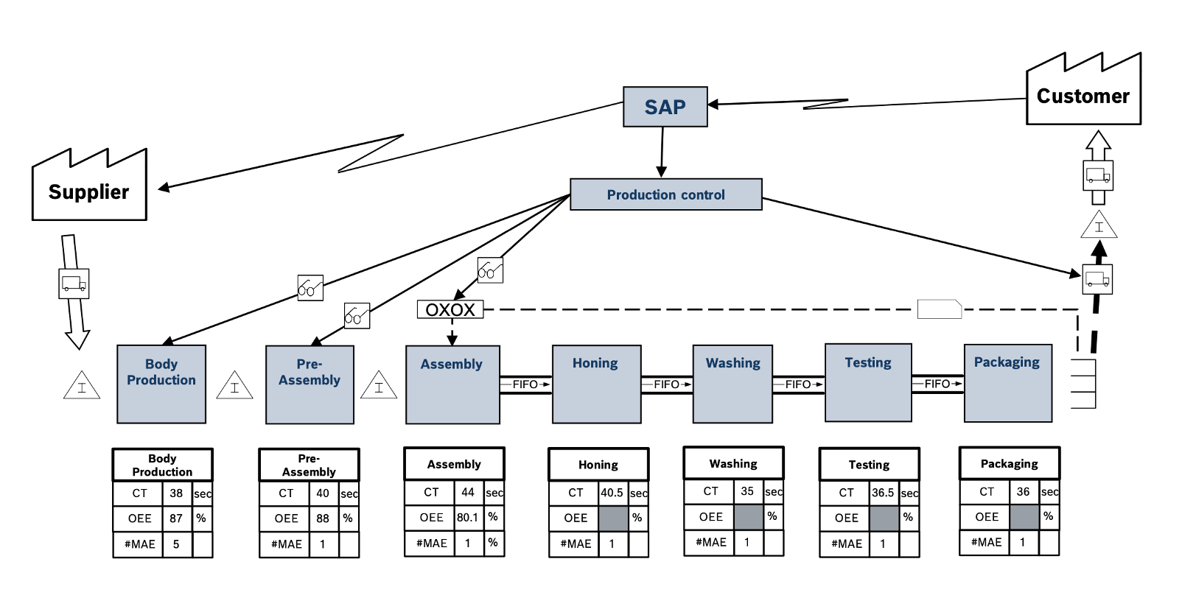
A Prototypical Production Line
Cognitively-Inspired Decision Intelligence for Manufacturing
ACS 2024, | Alessandro Oltramari- 06.19.2024

Slide 13
CIP-ACT-R: Model Design (in collaboration with Siyu Wu, PSU)
Cognitively-Inspired Decision Intelligence for Manufacturing
CIP-ACT-R: ACT-R model applied to Continuous Improvement Process in Bosch Production Systems
Version 1.0
Rule-based model in decision making
Learning to distinguish novice, intermediate expert decision combinations depending on feedback
Testing of simple rules first and switching to more complex rules later
The model learns over the course of trials and exhibits individual differences. It demonstrates a human-like learning progression, showing a steep learning curve at the beginning and gradual improvements later on 📘.
Version 2.0
Incorporate metacognitive processes of reflecting and evaluating the progress of the selected approach
Implementing a reinforcement-learning mechanism in a production-system framework
📘 Siyu Wu, Alessandro Oltramari, Frank E Ritter. “Toward Using Cognitive Architecture For Manufacturing Solutions”. Submitted to 17th International Conference on Social Computing, Behavioral-Cultural Modeling & Prediction and Behavior Representation in Modeling and Simulation (SBP-BRIMs)
ACS 2024, | Alessandro Oltramari- 06.19.2024

Slide 14
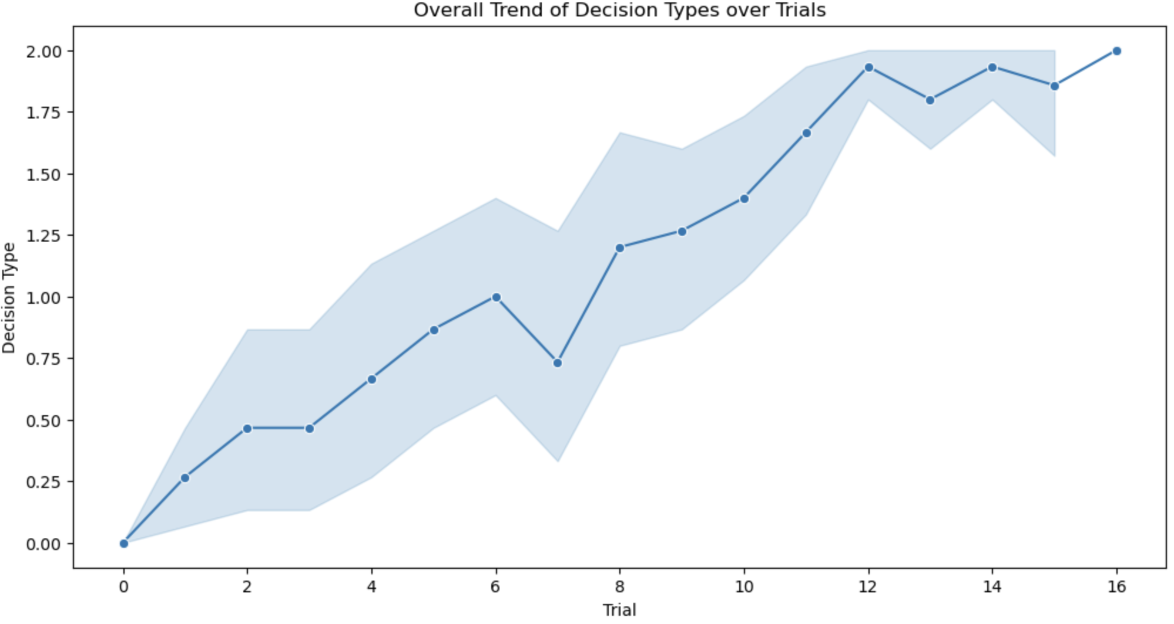
VSM-ACT 1.0
Cognitively-Inspired Decision Intelligence for Manufacturing
We run the model 15 times to better understand behavior, 15-16 trials per time
We collected data with decision types encoded as 0, 1, and 2 for, respectively, novice, intermediate, and expert strategies
Starting at approximately 0 in trial 0, the mean decision type rises to about 0.75 by trial 4 and reaches around 1.25 by trial 8. Despite slight fluctuations, the trend continues upward, with the mean decision type approaching 1.75 by trial 12 and around 1.9 by trial 16. The narrowing 95% confidence intervals, ranging from approximately 0.5 to 2.0 initially to 1.5 to 2.0 in later trials, indicate increasing consistency among participants’ decision-making abilities.
ACS 2024, | Alessandro Oltramari- 06.19.2024

Slide 15
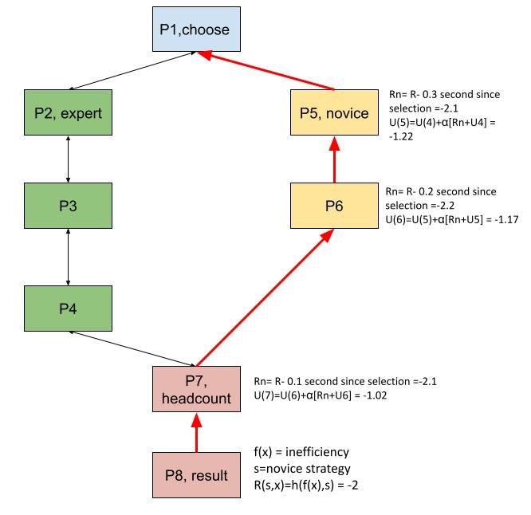
VSM-ACT-R 2.0
Cognitively-Inspired Decision Intelligence for Manufacturing
A penalty propagation for the novice strategy stems from head count cost inefficient decision
A (not depicted) reward propagation for the expert strategy stems from head count cost efficient decision
We are still working on refining reward function in reinforcement learning algorithm
ACS 2024, | Alessandro Oltramari- 06.19.2024

Slide 16
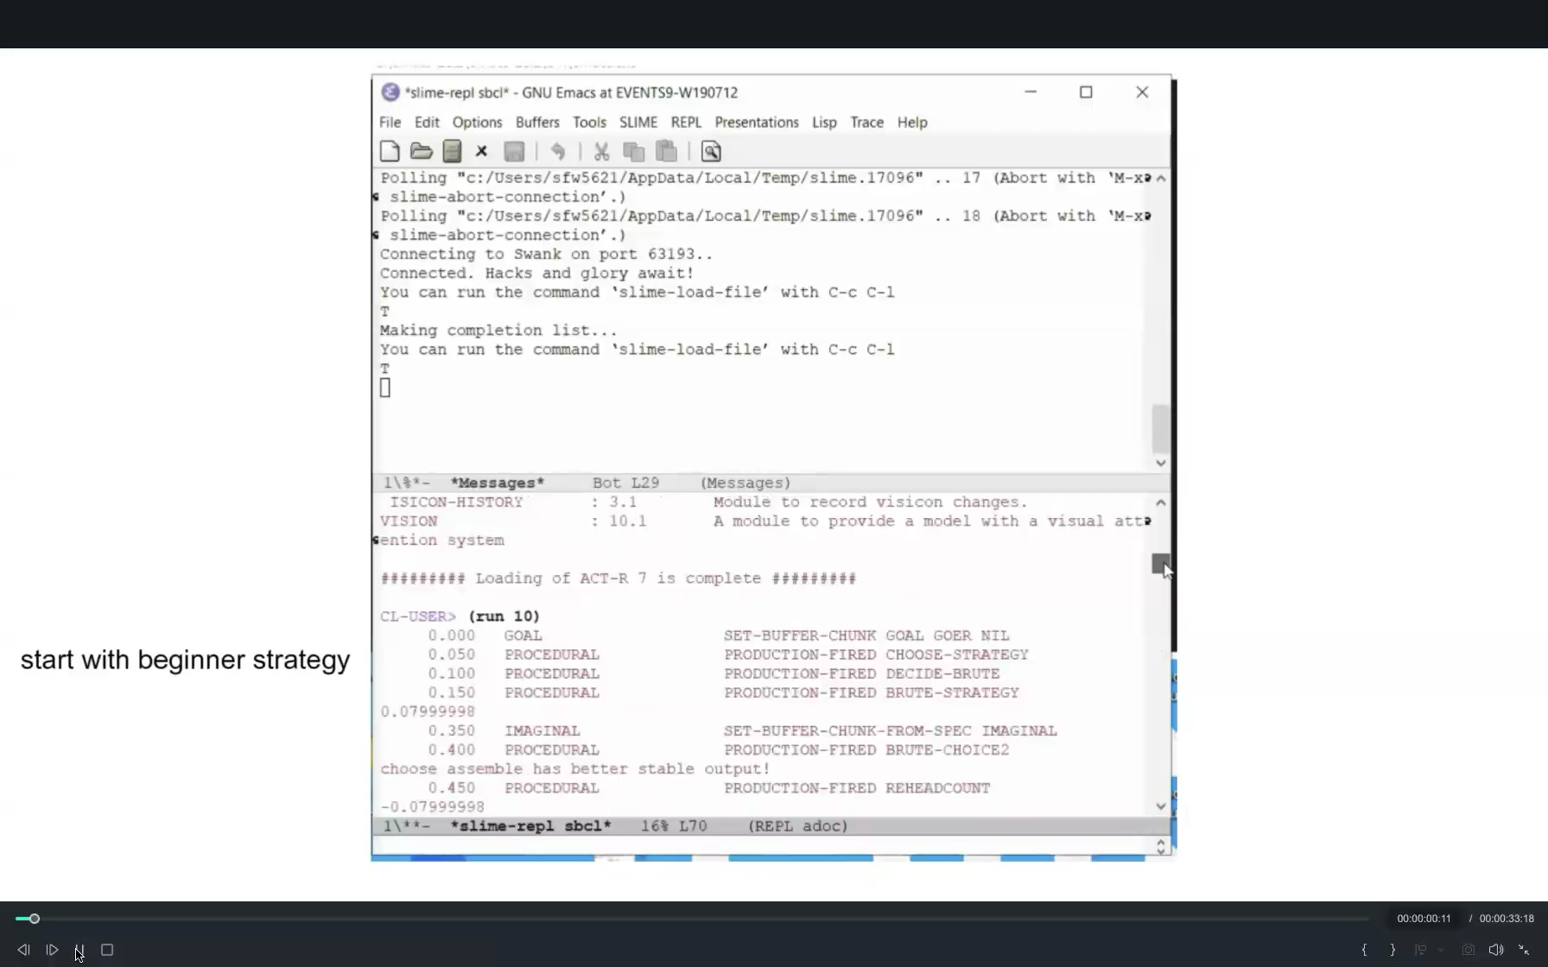

Slide 17
b
c
a
(a) We prompt the decision-making questions into Llama. (b) use Llama as the base model and get access to the last hidden layer for masked embeddings. (c) build a multi-classification layer upon the base model, using ACT-R decision-making strategy choices and results as the target classes and last hidden layer as features. (d) fine-tune the Llama model for multi-classification using LORA. (e) deploy the fine-tuned model in new inference tasks.
d
e

Slide 18
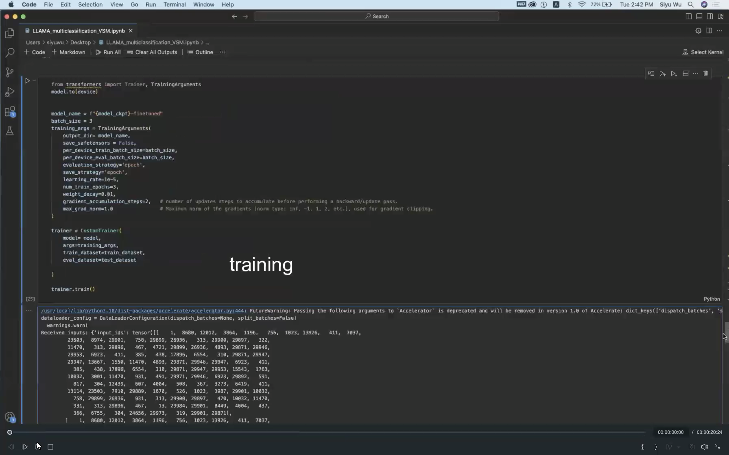
Fine-tuning LLAMA
Cognitively-Inspired Decision Intelligence for Manufacturing

Slide 19
(a)We prompt the verbatim of the ACT-R model trace and the corresponding decision-making questions into LLaMA separately
(b) extract the last hidden layer for masked embeddings, concatenate the embeddings, and (
c) feed them into a multilayer neural network with softmax activation.
(d) Build and train the neural network model using ACT-R decision-making strategies and results as targets. We refer to the developed neural network model as LLaMA-ACT-R for decision making.

Slide 20
Recent Work
Cognitively-Inspired Decision Intelligence for Manufacturing
AAAI-MAKE 2024: Kaushik Roy, Alessandro Oltramari, Yuxin Zi, Chathurangi Shyalika, Vignesh Narayanan, Amit Sheth, "Causal Event Graph-Guided Language-based Spatiotemporal Question Answering. In Proceedings of AAAI Spring Symposia 2024, Stanford, March 25-27.
ACM SIGKDD 2023: Zhang, Jiarui, Filip Ilievski, Kaixin Ma, Aravinda Kollaa, Jonathan Francis, and Alessandro Oltramari. "A study of situational reasoning for traffic understanding." In Proceedings of the 29th ACM SIGKDD Conference on Knowledge Discovery and Data Mining, pp. 3262-3272. 2023.
AAAI LLM-CA 2023: Alessandro Oltramari, "Enabling High-Level Machine Reasoning with Cognitive Neuro-Symbolic Systems”. In Proceedings of the AAAI Symposium Series, vol. 2, no. 1, pp. 360-368. 2023.
ACL-IJCNLP 2021: Chen, Xi, Lin, Faner, Zhou, Yeju, Ma, Kaxin, Jonathan, Francis, Eric Nyberg, Alessandro Oltramari. “Building Goal-oriented Document-grounded Dialogue Systems”
KBS Journal 2021: Ilievski, Filip, Alessandro Oltramari, Kaixin Ma, Bin Zhang, Deborah L. McGuinness, and Pedro Szekely. "Dimensions of commonsense knowledge”
COLING 2022: Ma, Ilievski, Francis, Nyberg, and Oltramari. "Coalescing Global and Local Information for Procedural Text Understanding." In Proceedings of the 29th International Conference on Computational Linguistics, pp. 1534-1545. 2022.
IOS Press 2020: Oltramari, A., Francis, J. Henson, C., Ma, K., and Wickramarachchi, R.. "Neuro-Symbolic Architectures for Context Understanding." In Knowledge Graphs for eXplainable Artificial Intelligence: Foundations, Applications and Challenges, pp. 143-160.
AAAI 2021: Ma, Kaixin, Filip Ilievski, Jonathan Francis, Yonatan Bisk, Eric Nyberg, and Alessandro Oltramari. "Knowledge-driven Data Construction for Zero-shot Evaluation in Commonsense Question Answering."
EMNLP-COIN 2019: Ma, Kaixin, Jonathan Francis, Quanyang Lu, Eric Nyberg, and Alessandro Oltramari. "Towards generalizable neuro-symbolic systems for commonsense question answering."
AAAI-CSKG 2021: Li, Yikang, Pulkit Goel, Varsha Kuppur Rajendra, Har Simrat Singh, Jonathan Francis, Kaixin Ma, Eric Nyberg, and Alessandro Oltramari. "Lexically-constrained Text Generation through Commonsense Knowledge Extraction and Injection."
…
Notes:
LLMs: prediction based on word distribution at massive scale, no high-level reasoning
Neuro-Symbolic LLMs: knowledge infusion provides more context, no high-level reasoning

Slide 21




Credits (Alphabetic Order)
Cognitively-Inspired Decision Intelligence for Manufacturing
Monireh Ebrahimi, Jon Francis, Cory Henson, Pascal Hitzler, Filip Ilievski, Christian Lebiere, Antonio Lieto, Kaixin Ma, Anees ul Mehdi, Eric Nyberg, Sarah Masud Preum, Ehsan Qasemi Frank Ritter, Kaushik Roy, Amit Seth, Siyu Wu
ACS 2024, | Alessandro Oltramari- 06.19.2024

Slide 22

THANKS!

Slide 23
LEFTOVERS

Slide 24
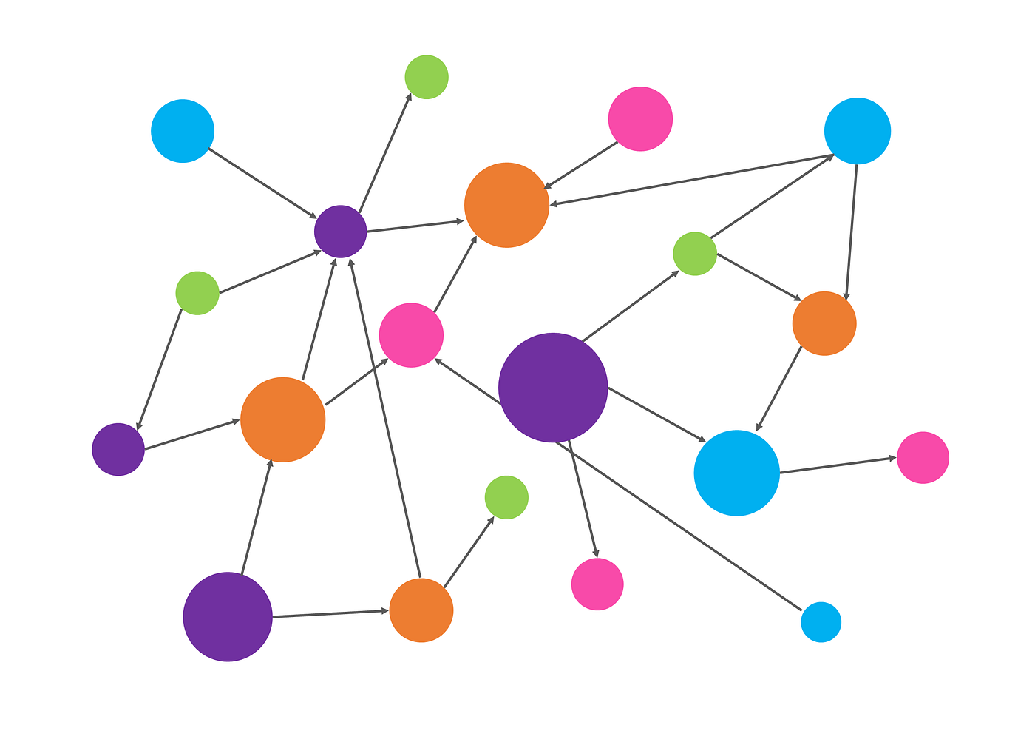
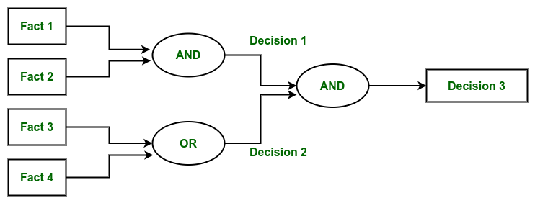


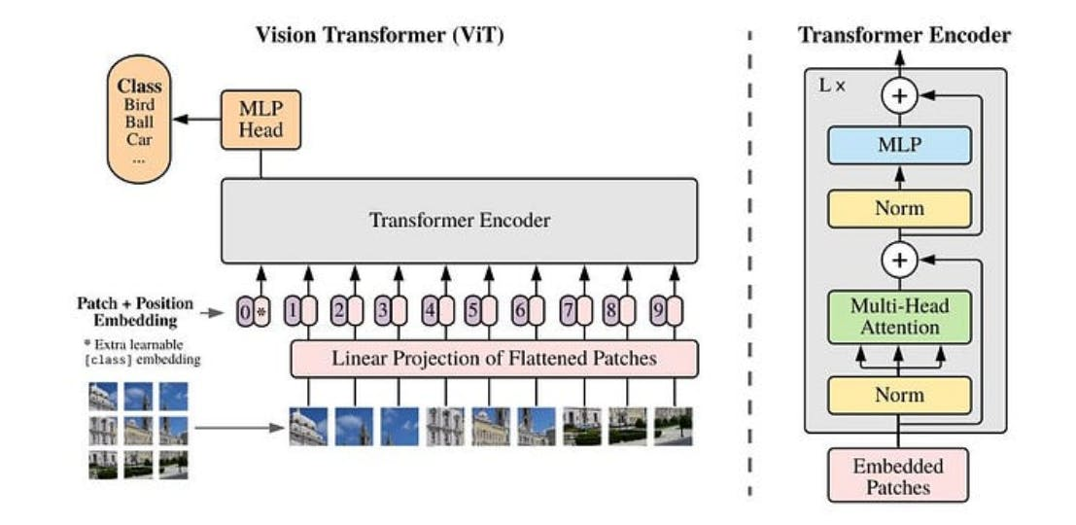

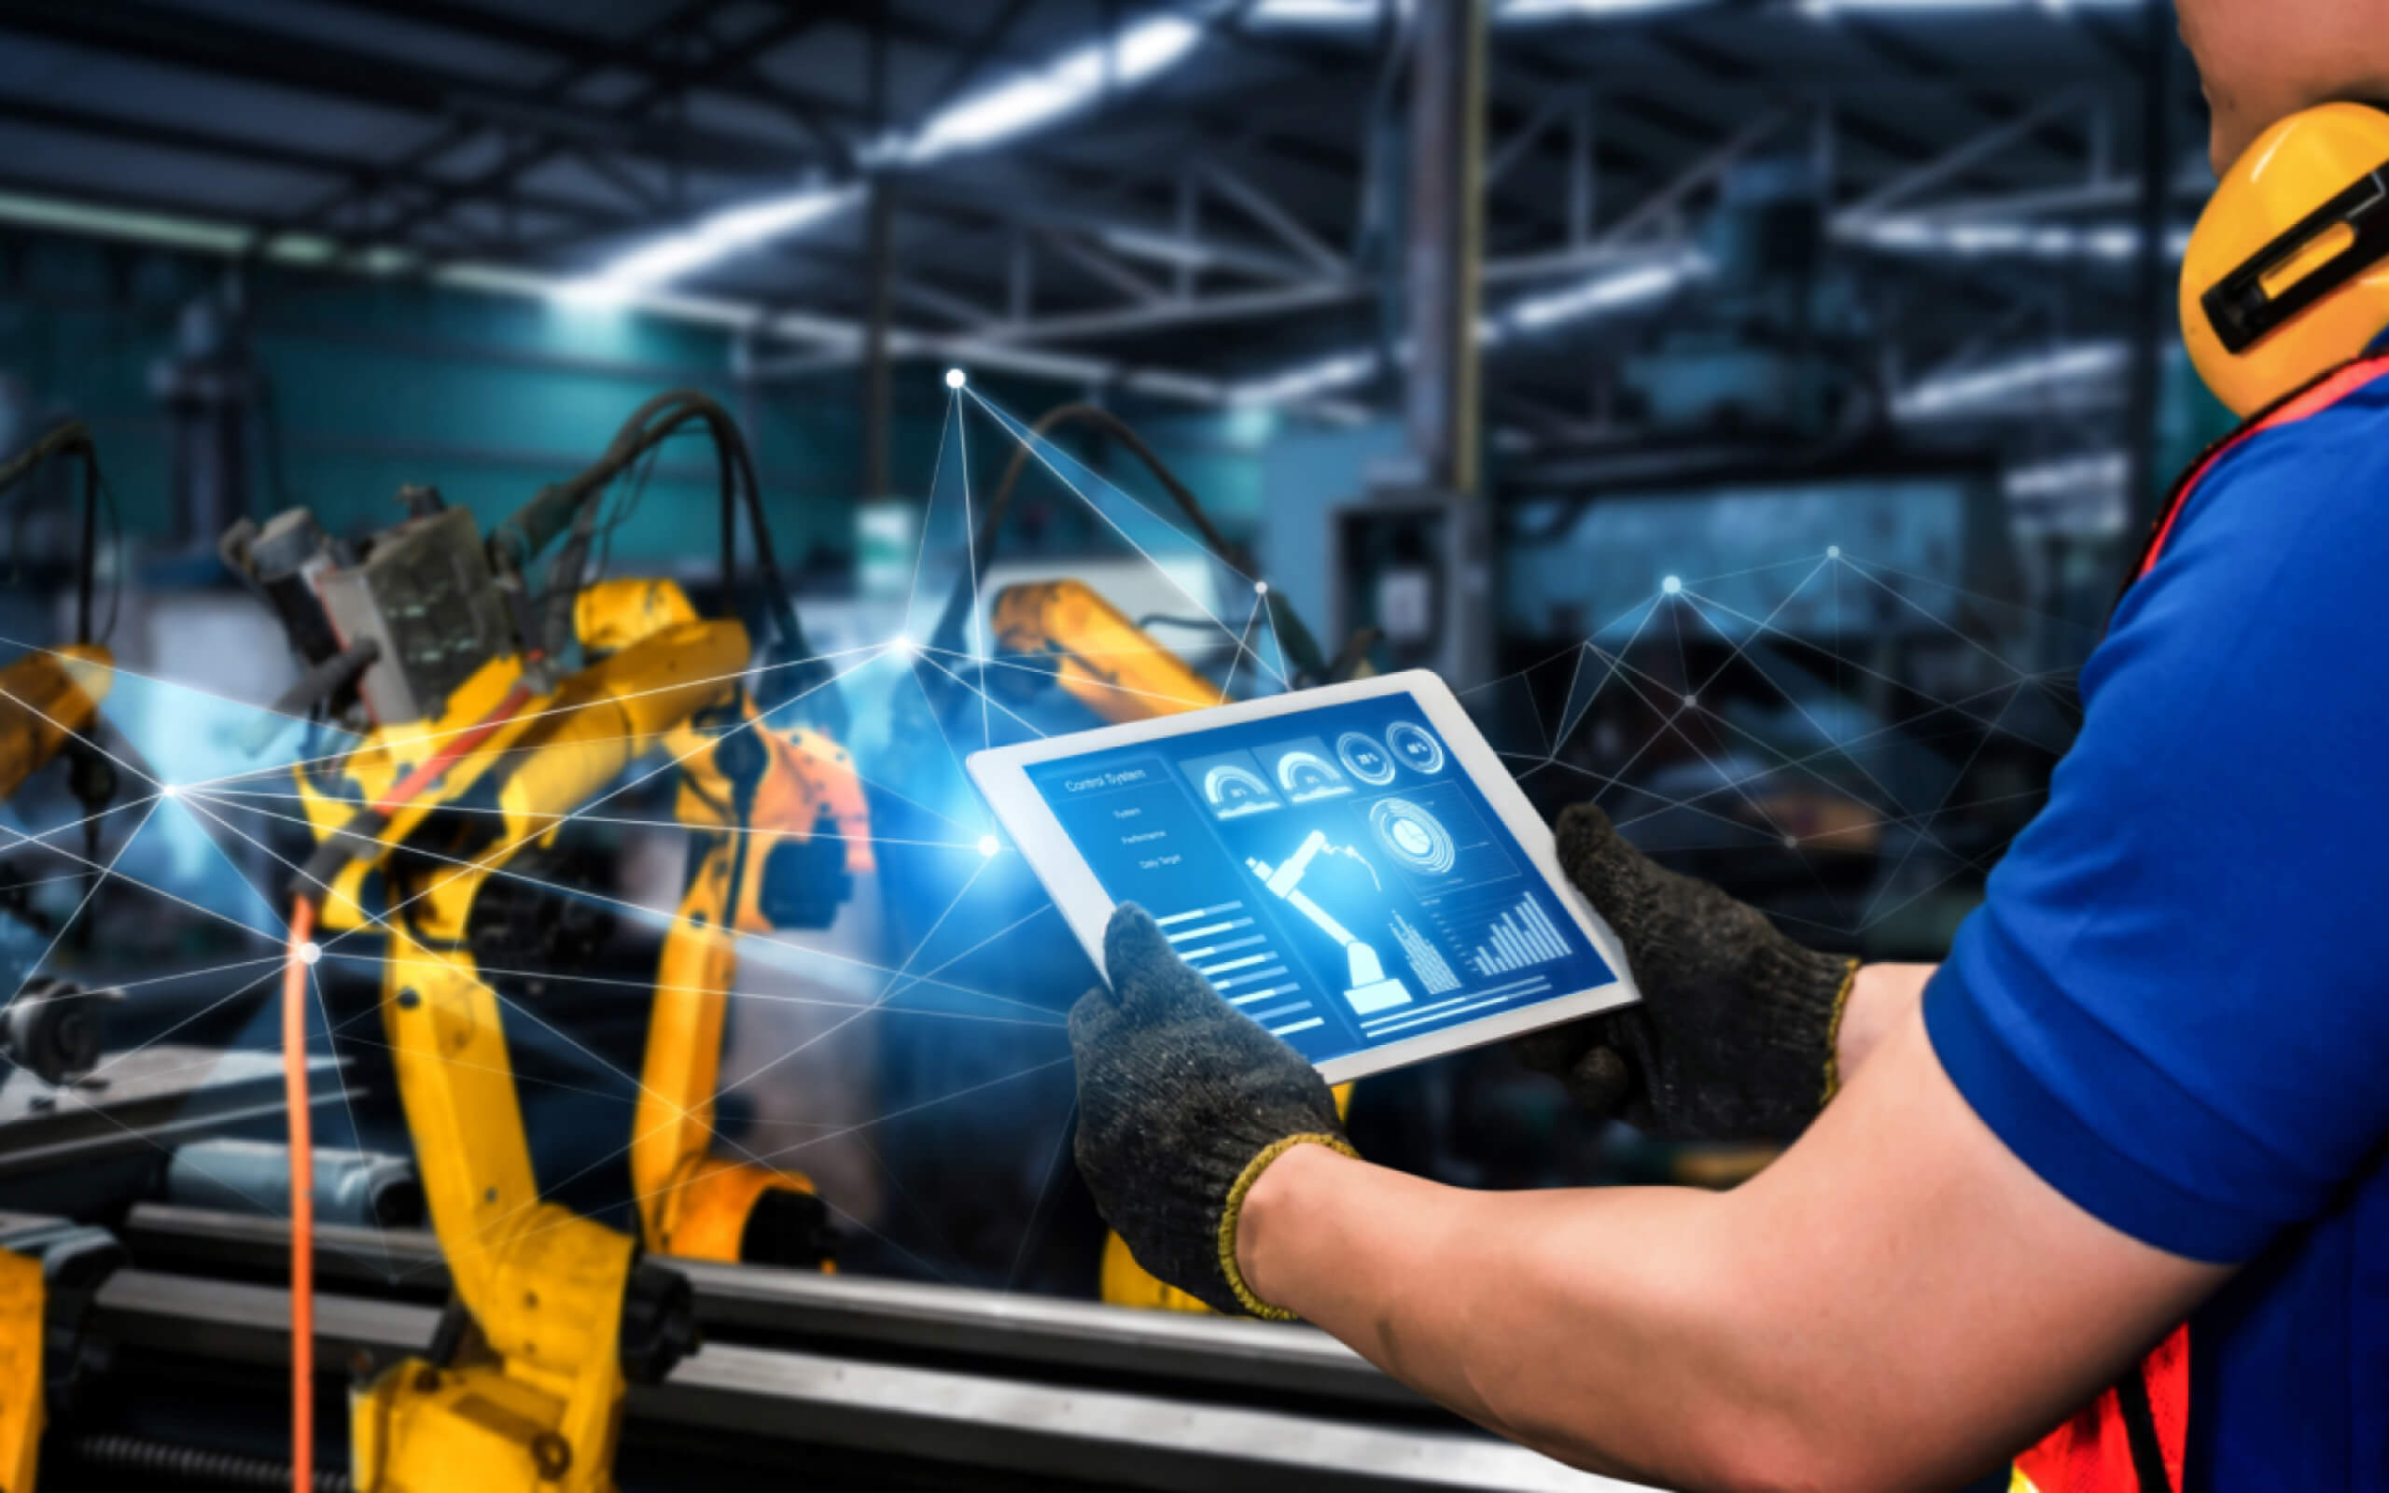




Our Solution: Integrating Cognitive Architectures & Neuro-Symbolic AI
*Image courtesy of Holly Sue Hake, University of Washington
Cognitively-Inspired Decision Intelligence for Manufacturing
Symbolic AI (KGs, rules, etc.)
knowledge
Neural AI (LLMs, MM, etc.)
learning
Patent App. No.: 18/128073 (05/2023)
Cognitive Architecture (ACT-R, SOAR)
*
cognition
ai systems for
decision intelligence
Notes:
How do cognitive architectures fit in the NeSy picture? With cognitive models we can build systems that replicate human decision makers – transform into triangle

Slide 25

Outline
Cognitively-Inspired Decision Intelligence for Manufacturing
Our Group
Motivations
Use Case
Approach and Methods
Future Work
ACS 2024, | Alessandro Oltramari- 06.19.2024

Slide 26
Bosch Research in North America
Cognitively-Inspired Decision Intelligence for Manufacturing
North America
Boston
Research and Technology Center
Technology scouting in America and research in the areas of
Human-Machine Intelligence
Modeling, Design and Control of Energy Systems and Materials
Secure and Intelligent IoT
Intelligent and Connected Sensors and Systems
Sunnyvale
Pittsburgh
Notes:
Each location focuses on specific research topics

Slide 27
The Causal Analysis and Decision Intelligence Group (CADI)
Cognitively-Inspired Decision Intelligence for Manufacturing
neuro-symbolic ai
causal analysis
decision intelligence
Bosch has vast amounts of highly valuable data and rich domain expert knowledge
Neuro-Symbolic AI enables automatic distillation of insights from data and exploitation of expert knowledge for causal analysis and decision intelligence
Current focus on cost savings and process optimization in manufacturing
Causal AI is a set of techniques for discovering causal relations and making inferences beyond mere correlation
Causal Neuro-Symbolic AI is the integration of Causal AI with knowledge graphs and machine learning
Applications in manufacturing
Finding root causes for anomalies
Predicting the quality of products
Optimizing process chains
Decision intelligence (DI) aims to support, augment and automate human decisions by linking data with outcomes
Contemporary DI is genuinely neuro-symbolic as it combines machine learning algorithms with knowledge graphs and rule-based systems
Applications in manufacturing: Continuous Improvement Process (CIP)
Guide interventions during ramp-up phase of production line reconfiguration
Optimization of flexible manufacturing
*CGM: Causal Graph Model

